Slide 1



Custom Metal Box
MEMSDuino
Lafe Spietz
NIST
2024

Slide 2
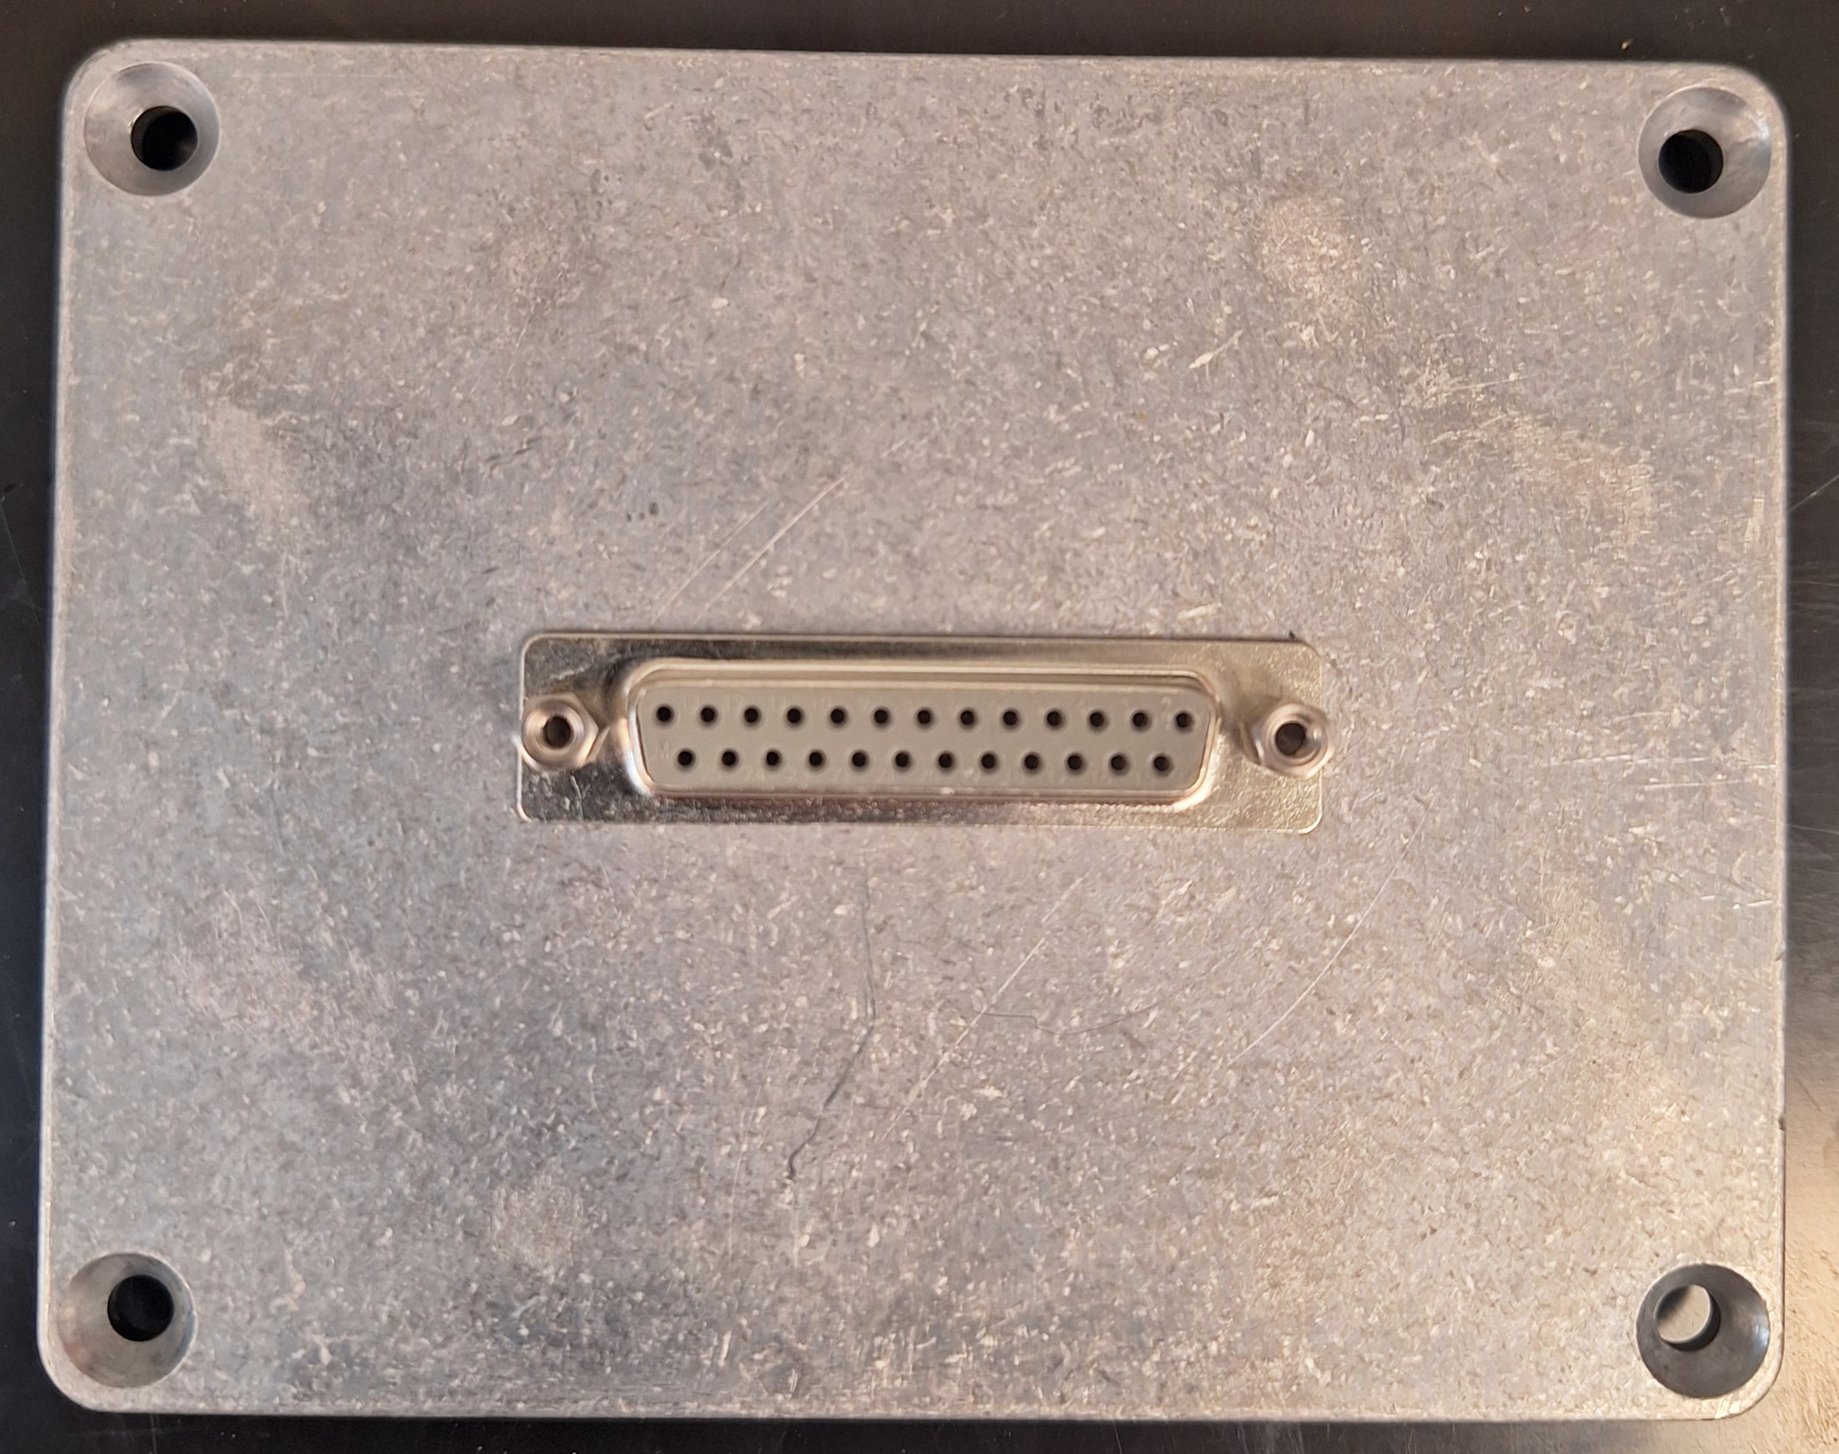
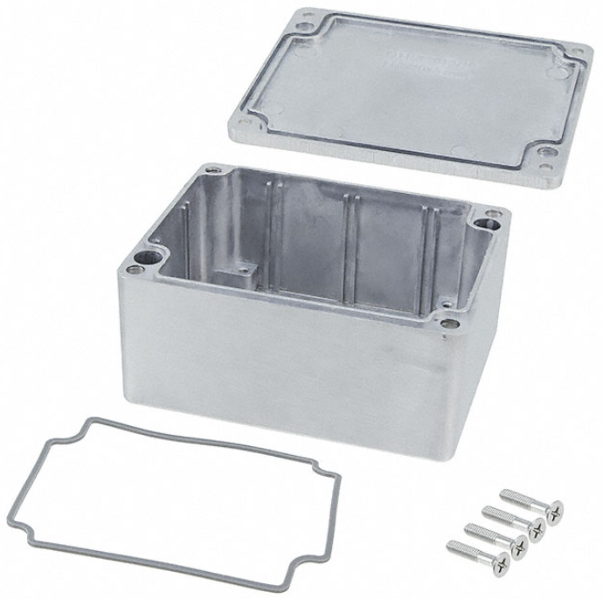
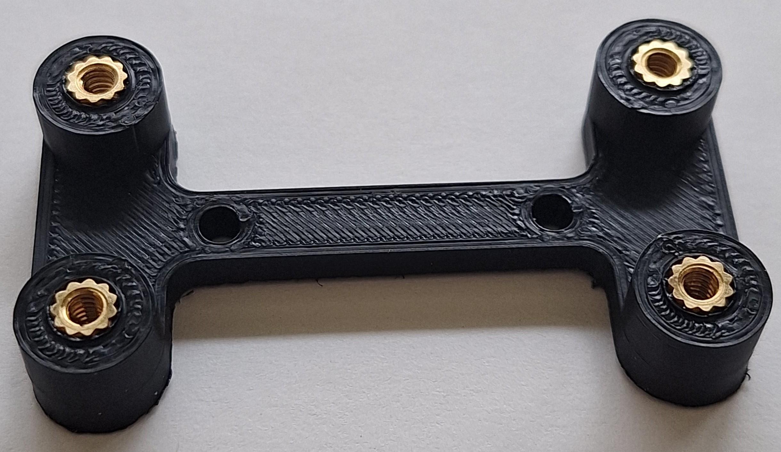
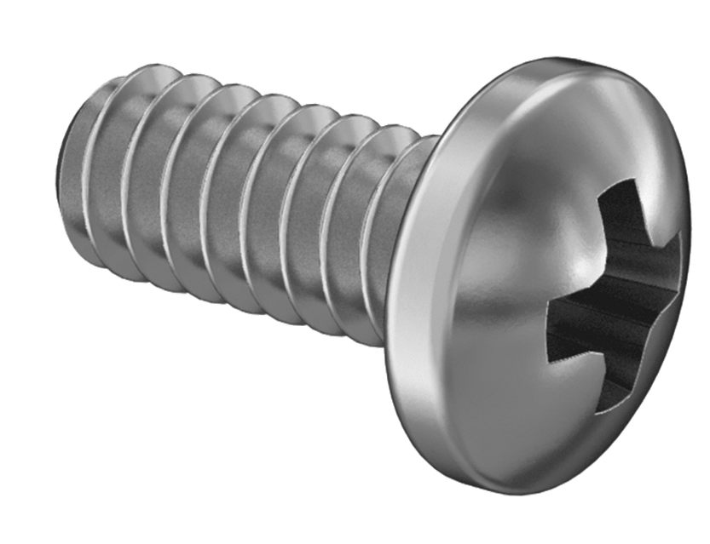
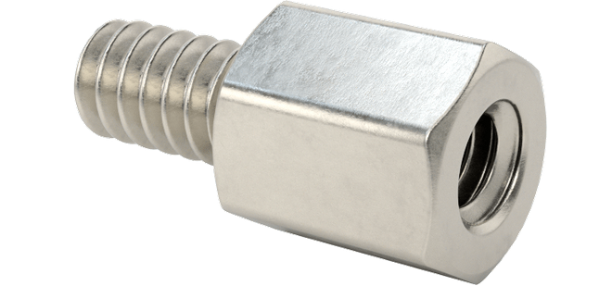
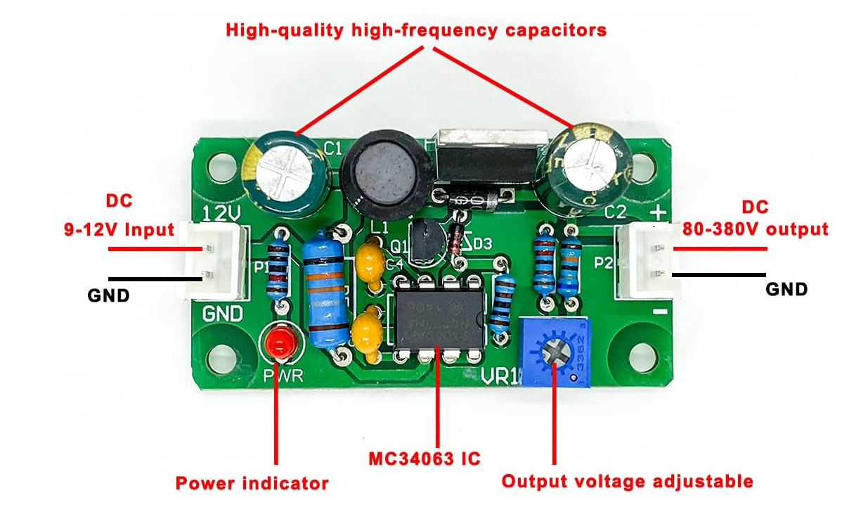
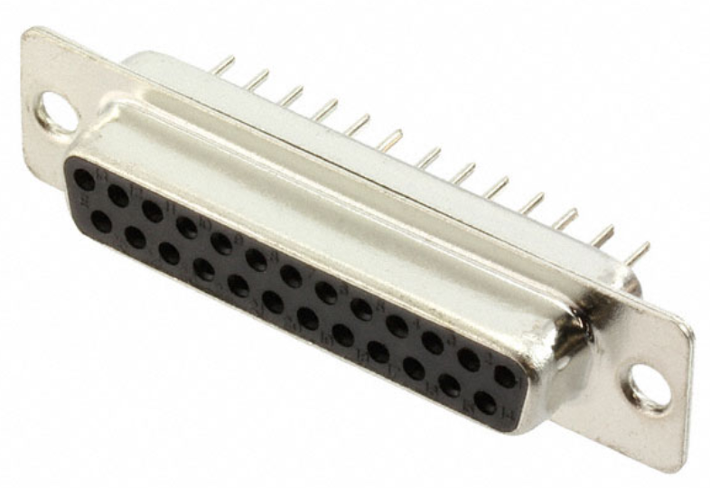
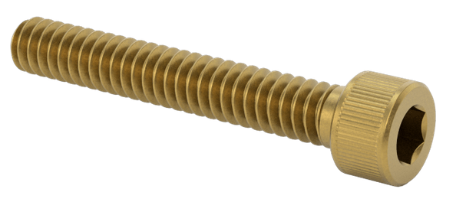
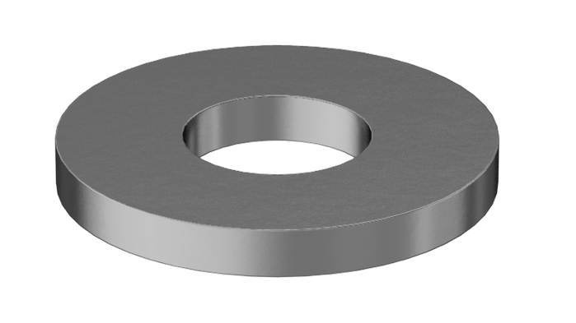
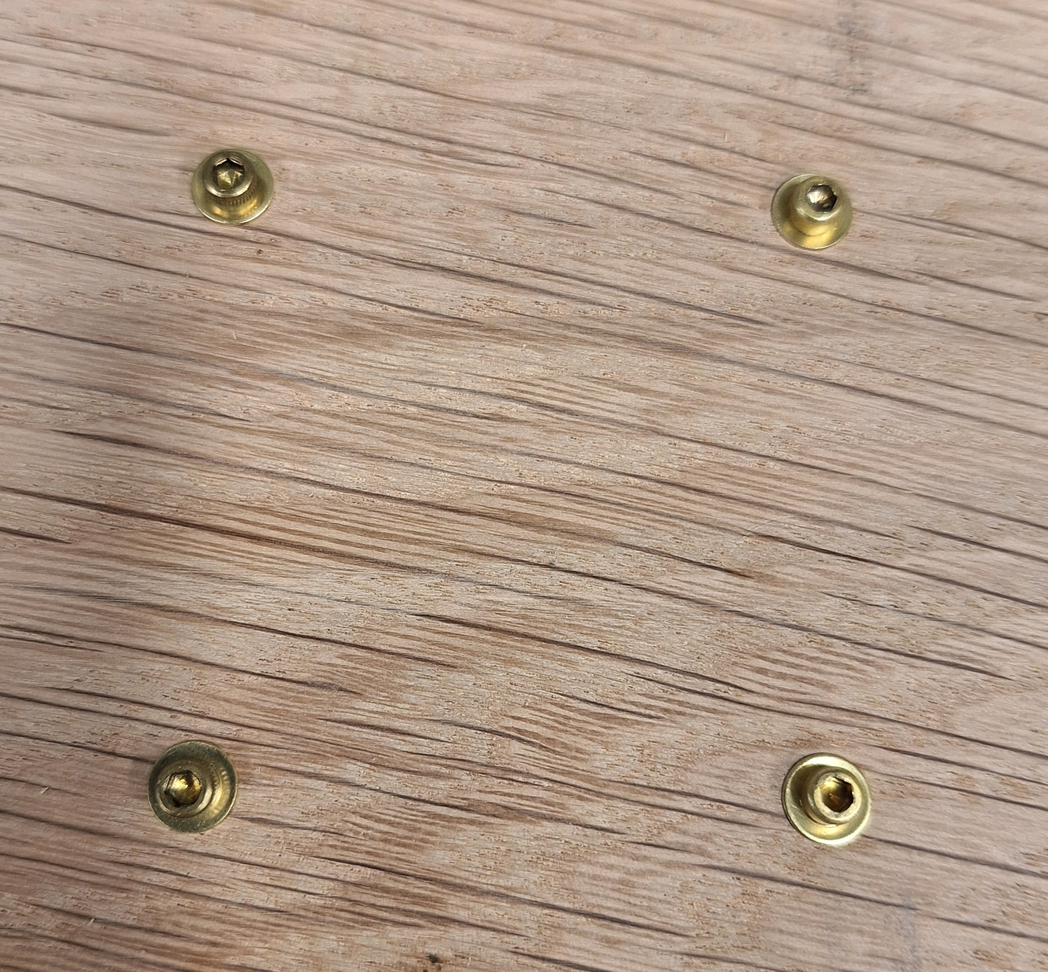
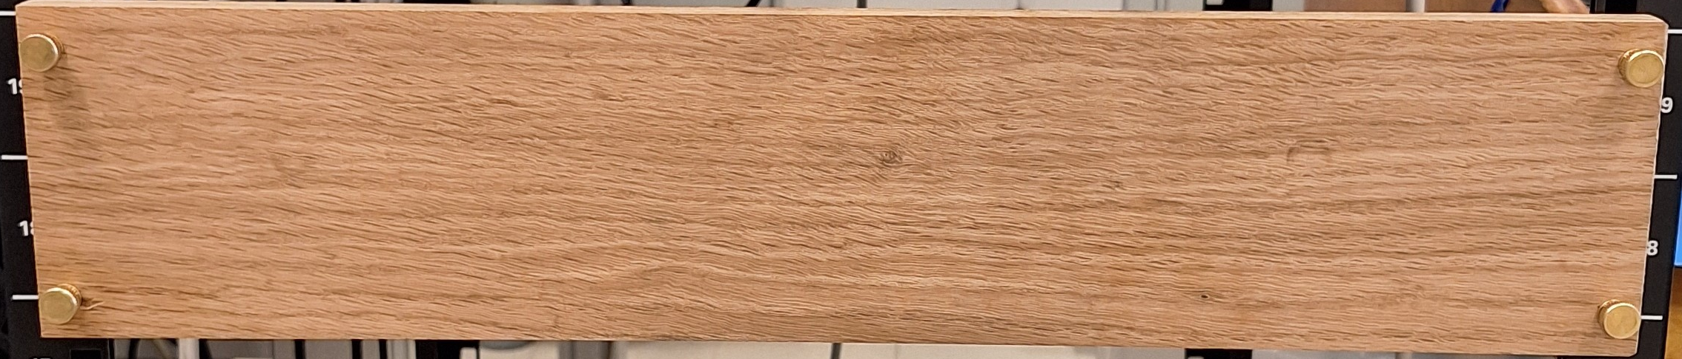
X6
X2
¼” 4-40 screws
HV-DCDC-bracket
7/32” 4-40 standoff
Bud AN-1304-A Diecast Aluminum Box
¾” 4-40 screws
X4
12V to 90 V Boost
#40 washers
Rack Mount Wood Board
MEMSDuino

Slide 3
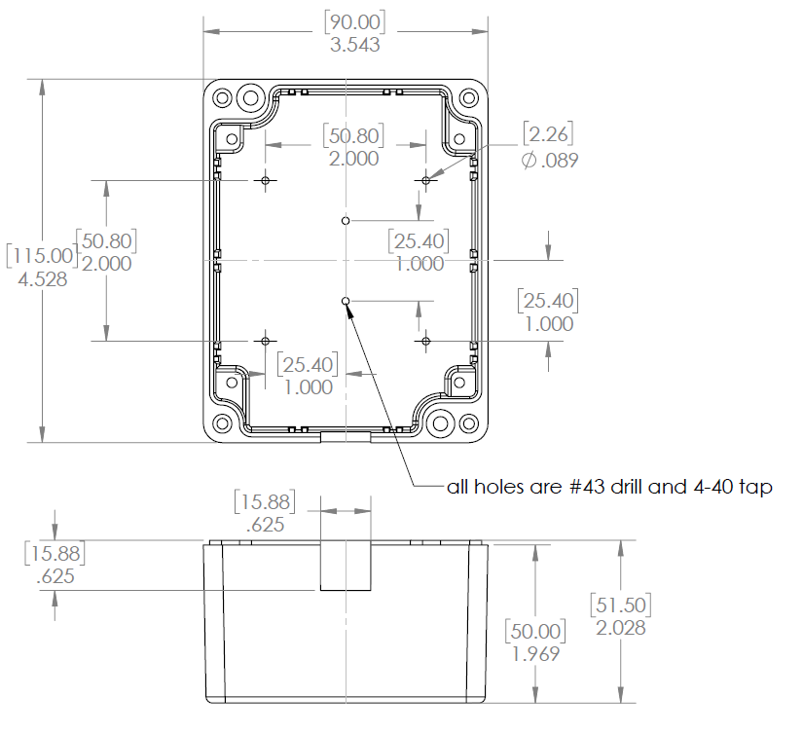
Modify or buy already-modified AN-1304-A box as follows:
MEMSDuino

Slide 4
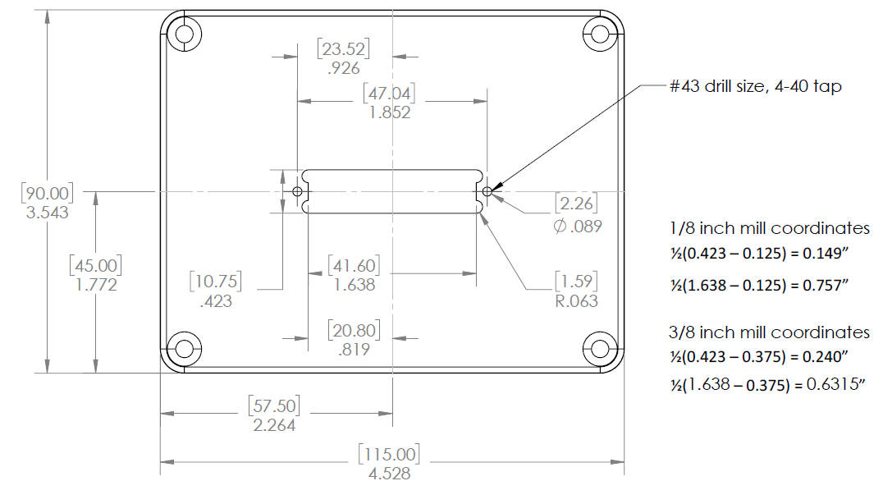
Modify or buy already-modified AN-1304-A lid as follows:
MEMSDuino

Slide 5
Screw DB25 Connector to lid using 7/32” 4-40 standoffs:
MEMSDuino

Slide 6
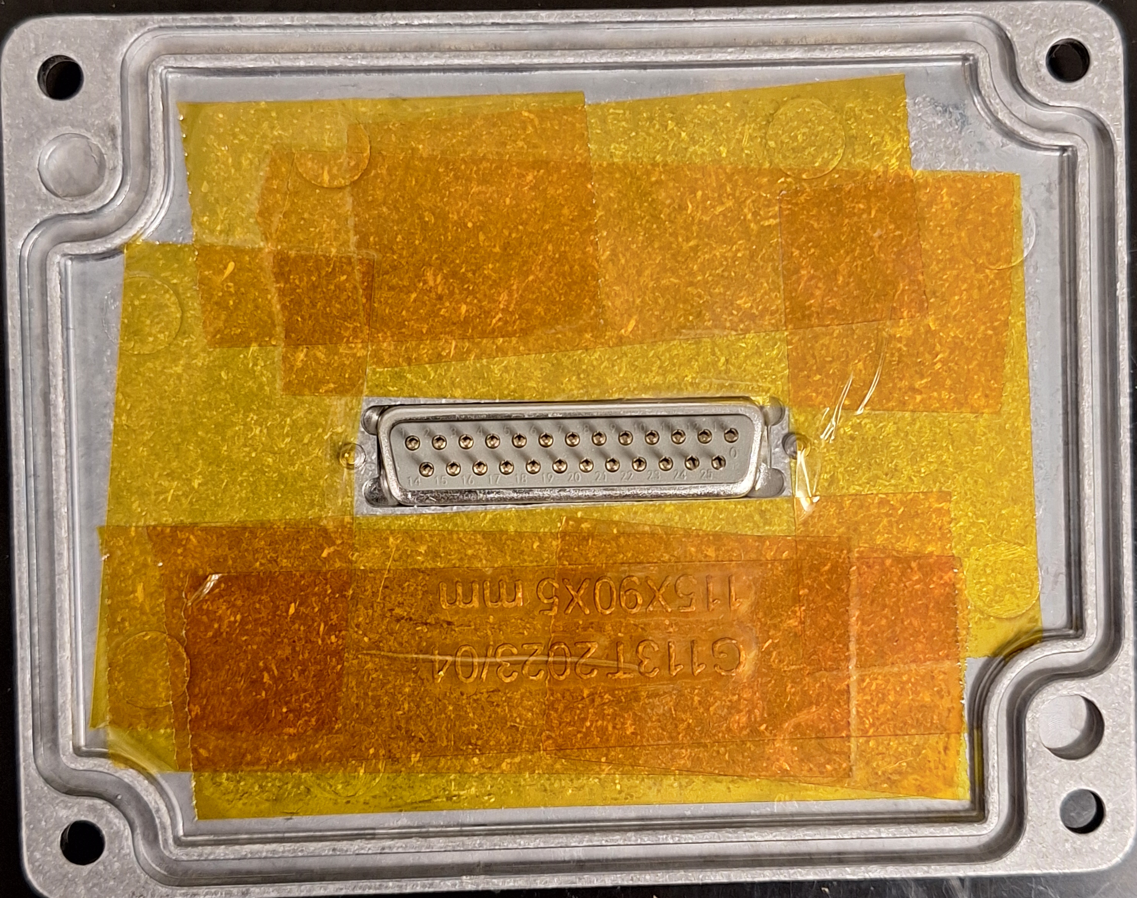
Add polyimide tape to lid to prevent possible shorts
MEMSDuino

Slide 7
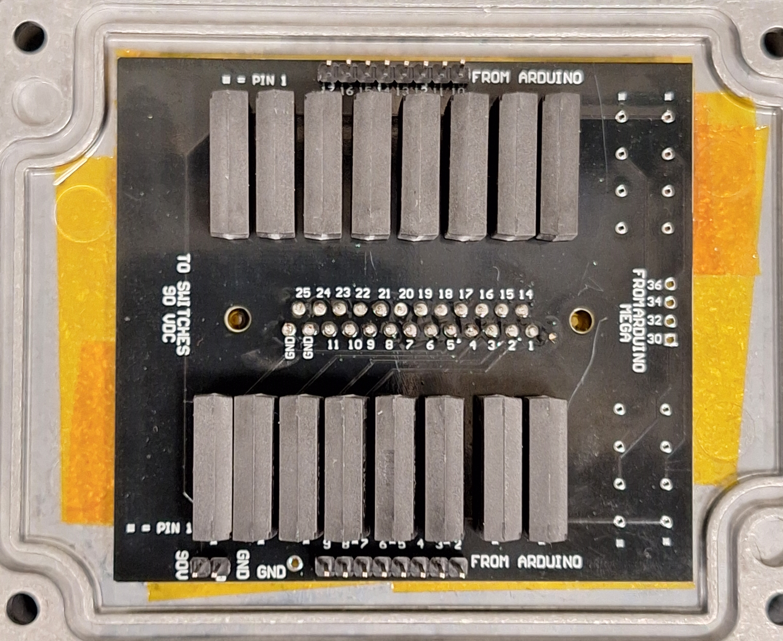
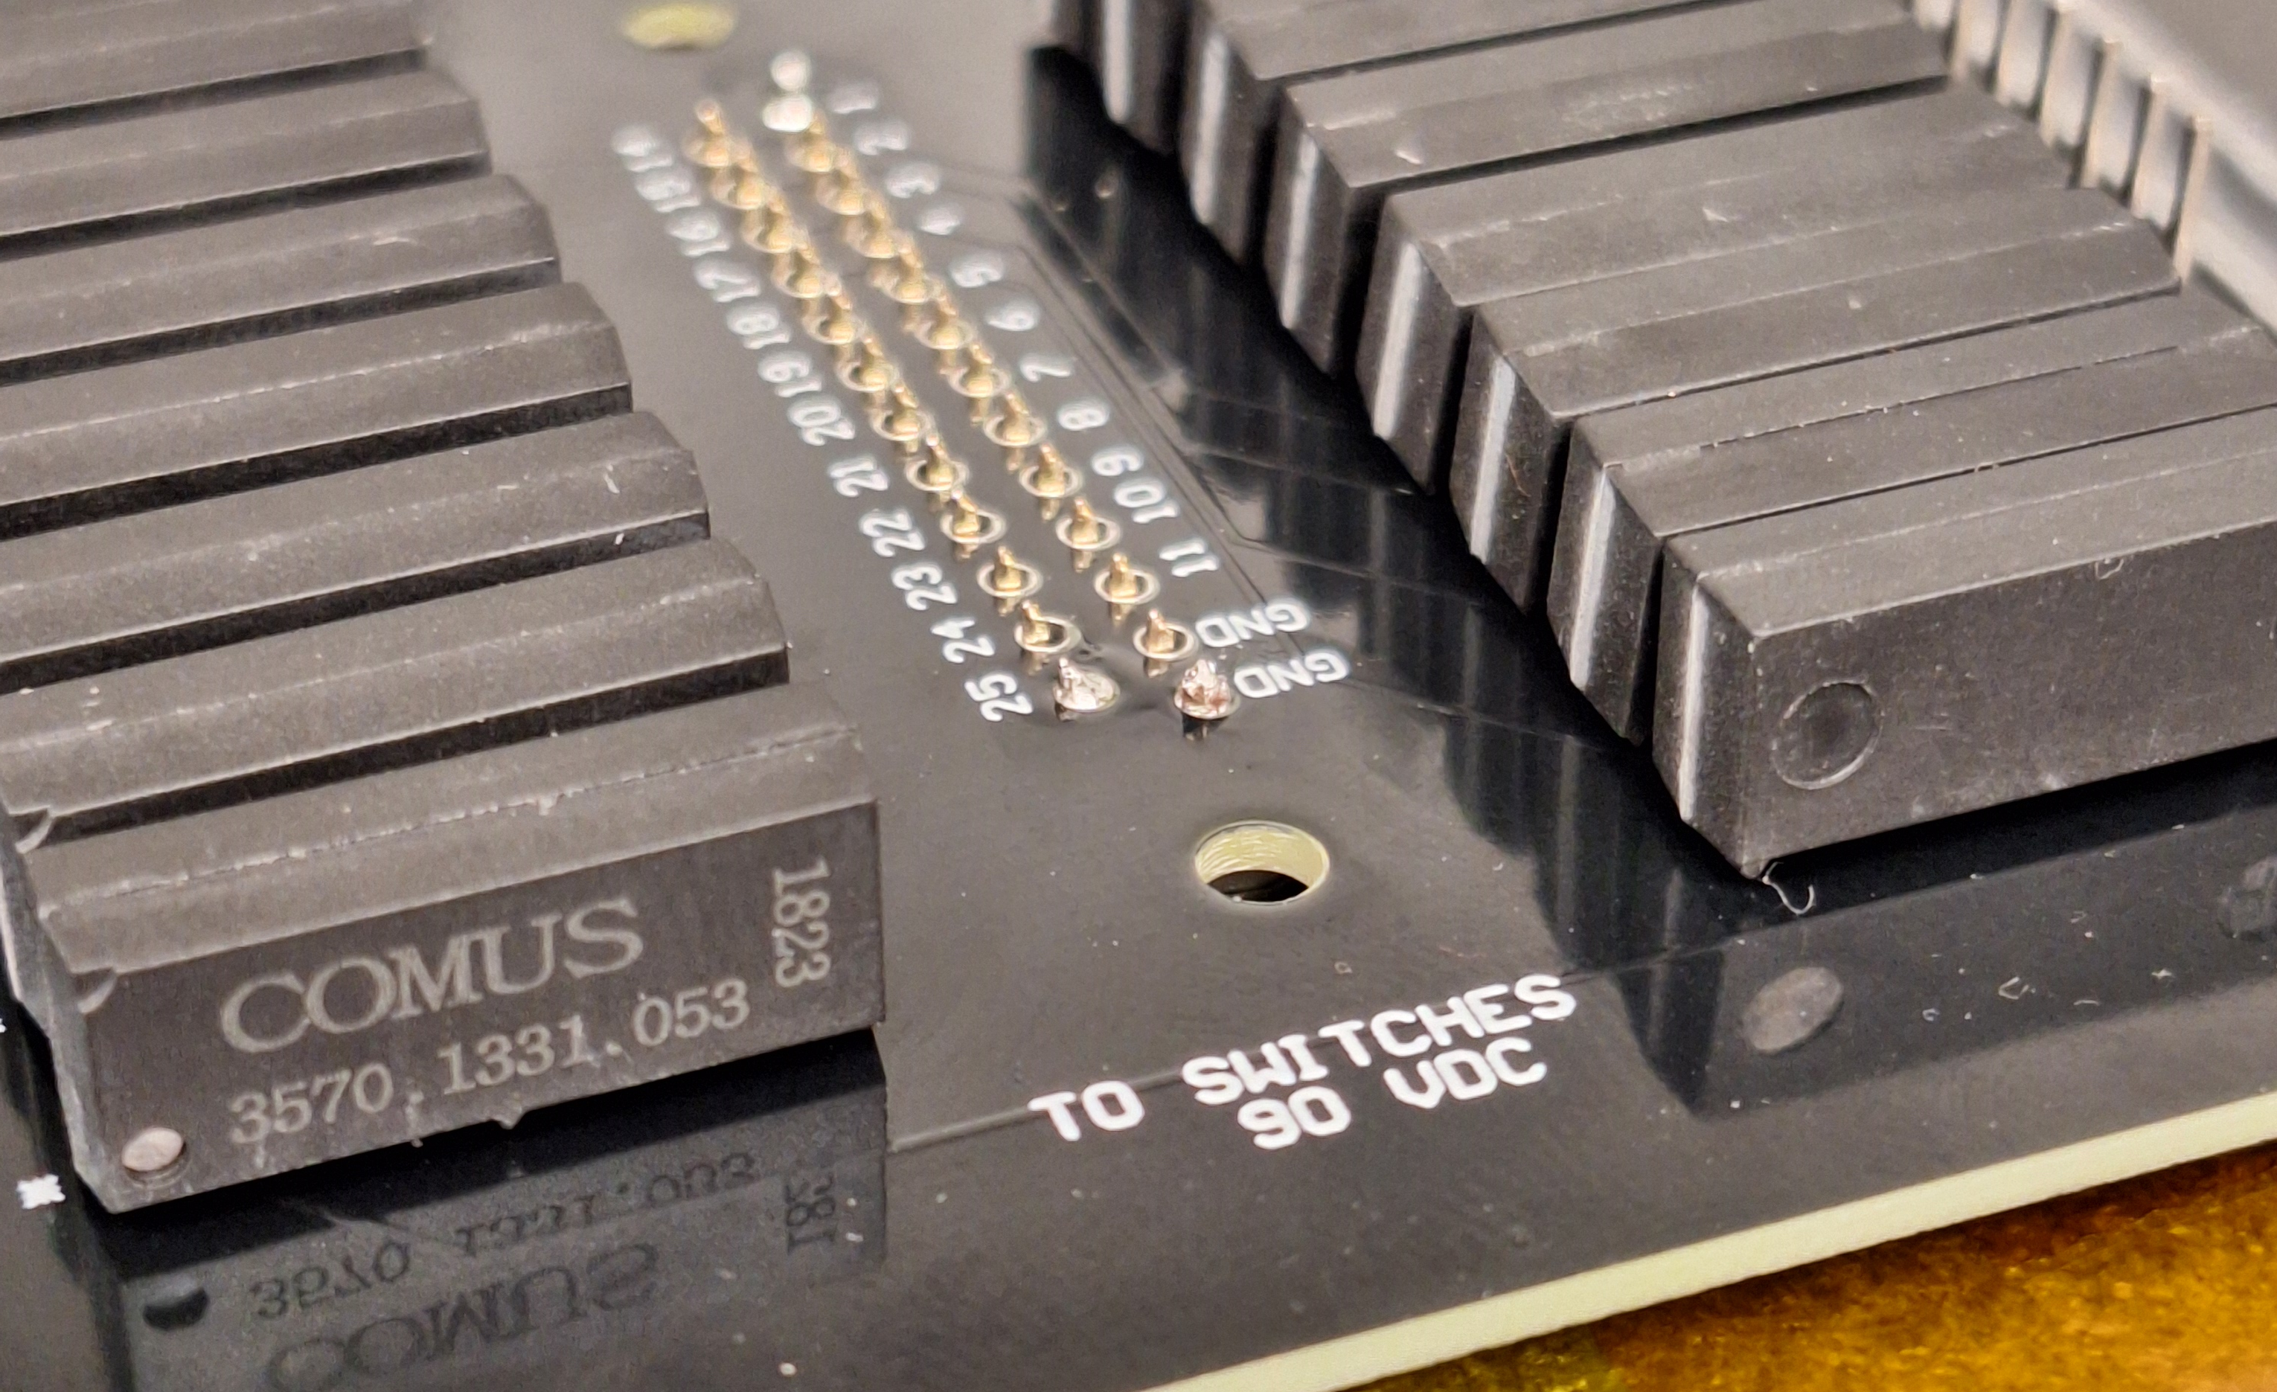
Solder already-assembled DB25 relay circuit board to DB25 connector, adding some space deliberately along the pins
MEMSDuino

Slide 8
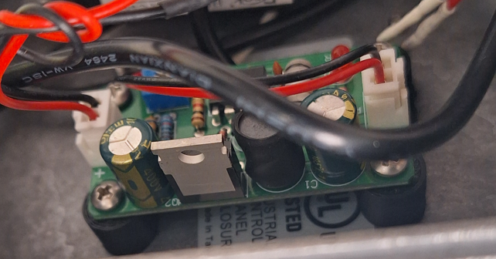
Use 4-40 screws to assemble the DCDC HV mounting bracket to the box, and the high voltage boost board to the bracket
X6
MEMSDuino

Slide 9
Use ¾” 4-40 screws to attach the main box to the wood board, with washers for each screw:
X4
MEMSDuino

Slide 10
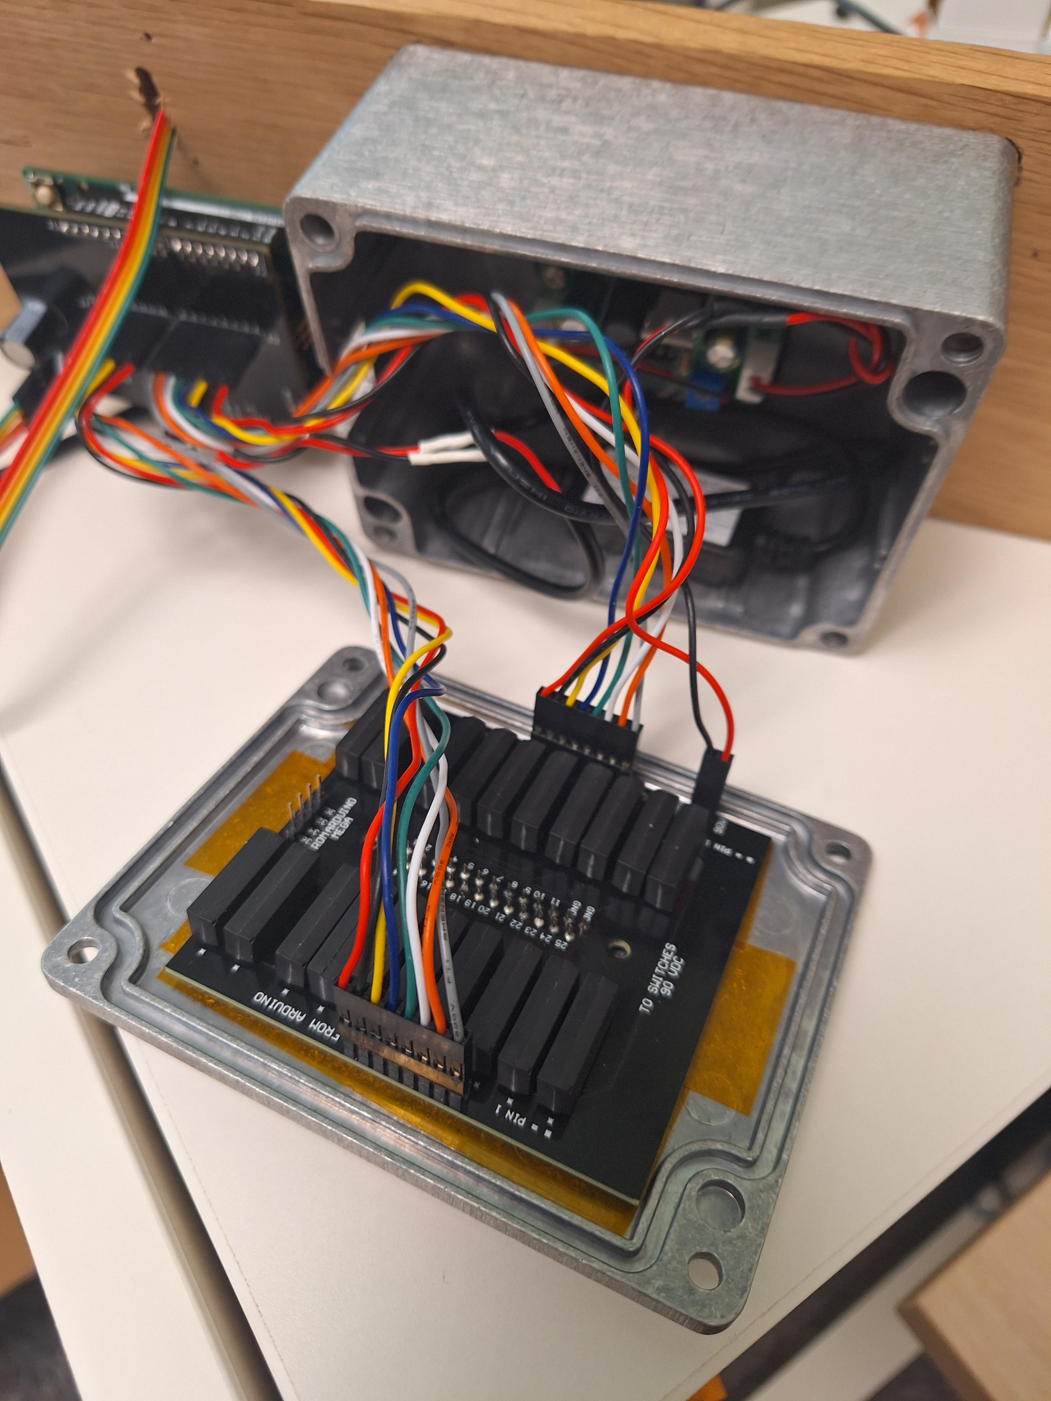
Assemble cables, matching red wire to lowest pin number on both ends, being careful to keep track of which 8 pin cable is which.
MEMSDuino

